Slide 1
Data Cleaning

Slide 2
1. What happens when errors and outliers skew your data? You clean the data.
2. What happens when state data is entered as CA or California or Calif.? You clean the data.
3. Null values are changed and standard formatting implemented, ultimately increasing data quality.

Slide 3




Datasets are not always perfect. Data duplication or missing values can affect the analysis process.
Missing Values
Often missing values are represented with "NA" or "-" or similar indicators and need to be replaced with before processing numeric data. Missing data can be verified as:
guest_list_df.isnull().values.any() # verify if any value is null
guest_list_df.isnull().sum() # display summary of null values per column
While reading data from files, missing values can be handled using property which can take a list of values to replace with
guest_list_df = pd.read_csv("daily_show_guests.csv", na_values = ['NA', 'N/A','-']])
fillna: To replace values with desired value.
product_data={'product': ['E-book', 'Plants'], 'unit_sold': [12, np.NaN]} # need to import numpy as np
product_df = pd.DataFrame(data=product_data)
product_df.fillna(0, inplace=True)

Slide 4
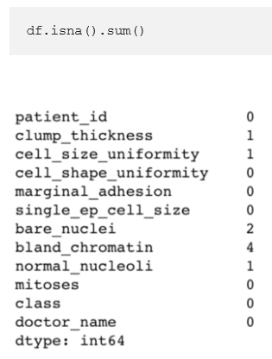

Dealing with missing values
We can sum up the total missing values using the following:
Now that we have identified our missing values, we have a few options.
We can fill them in with a certain value (zero, mean/max/median by column, string) or drop them by row.
Since there are few missing values, we can drop the rows to avoid skewing the data in further analysis.
This allows us to drop rows with any missing values in them.

Slide 5
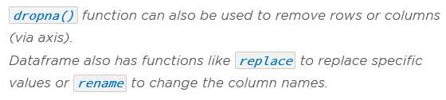

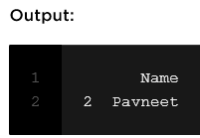
function can also be used to remove rows or columns (via axis).
Replace
Dataframe also has functions like to replace specific values.
rename
to change the column names.
Duplication
df = pd.DataFrame({'Name':['Pavneet','Pavneet']}, index=[1,2])
df.drop_duplicates(subset='Name',keep='last')

Slide 6
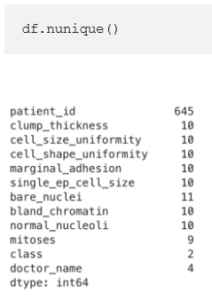
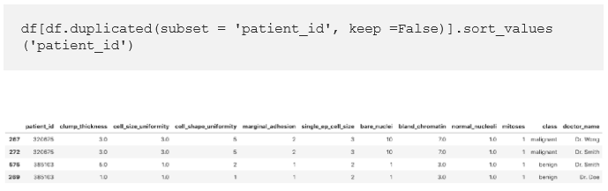
Inspecting duplicates
To view repeating rows we can start off by looking at the number of unique values in each column.
We see here that although there are 699 rows, there are only 645 unique patient_id’s. This could mean that some patient appear more than once in the dataset. To isolate these patients and view their data, we use the following:
This line displays all the duplicated patient_id’s in order.

Slide 7
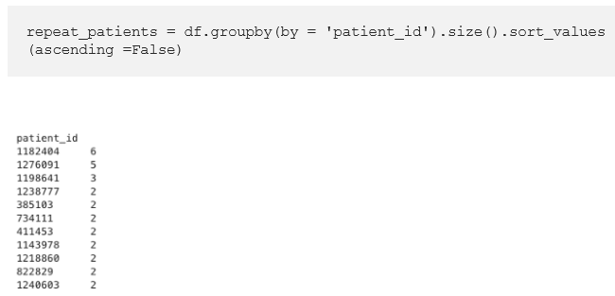
The number of times a patient shows up in the dataset can also be viewed.
This shows that one patient shows up in the data 6 times!

Slide 8
